Slide 1
Mapping existing trees on campus

Slide 2
Targeted at New Science Standard:
5-ESS3-1. Obtain and combine information about ways individual communities use science ideas to protect the Earth’s resources and environment.
Notes:
Click on the standard in presentation mode for a hyperlink to NGSS.

Slide 3
Summary
This fall, 12 new shade trees will be planted on campus. They will provide many environmental benefits: they will help clean our air and water, help us use less energy for air conditioning, and help fight climate change. We call these environmental benefits “ecosystem services.” In this activity, students will get to know some of the trees that are already on campus.
The students will be provided with aerial photographs [included below]. Outside, they will choose one small, one medium, and one large tree, enter their trees on the site plan, and collect some data on the trees. Back in the classroom they will use resources to determine the ecosystem services the trees are providing and compare the value of the small, medium and large trees.
[To edit this document directly, you can find it here: http://goo.gl/3LGQmd. Please save your own copy!]

Slide 4
Objectives
Get students outside, amongst the trees. Help them feel a connection to the nature on their campus, partly as a way to support the survival of the new trees.
Help them understand how trees help us improve the environment by cleaning the air and stormwater, reducing energy use, and removing greenhouse gases to fight climate change.
Demonstrate that large trees provide greater benefits than small trees. So (a) as trees get older and larger, their benefits increase and (b) some trees never get big, so they never provide as many benefits.
Learn about reading maps/site plans, data collection.

Slide 5
Required tools:
(a) Measuring tape for measuring trunk circumference or (b) string pre-marked in increments of centimeters or inches.
If using string, a length of string 4.5 ft long to indicate the height above the ground at which the tree’s circumference should be measured.
Ruler or yardstick for measuring students’ height.
Data collection sheet [included below]
Aerial images of school grounds [included below]

Slide 6
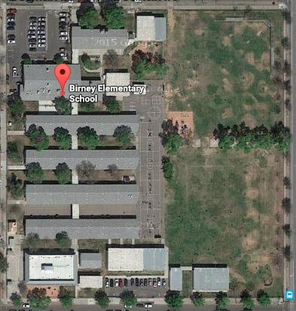
Step 1: Divide students into small groups. Provide each group with:
Measuring tape or two strings (one marked with inch/cm increments and one 4.5-ft long)
Ruler or yardstick
An aerial image of the school grounds
Data collection sheet

Slide 7
Step 2: Each group selects three trees, one small, one medium, one large. The groups move from tree to tree, entering them on the map and collecting some data (trunk circumference, tree height) [data sheet provided at the end of this doc].
Tree # 1
Tree # | Tree size/ species | Trunk circumference | Tree height
1 | Large | 24 inches | 30 ft
2 | Medium | 12 inches | 15 ft
Tree #2

Slide 8
Step 2, cont.: Collecting data
Measuring trunk circumference
The standard way to measure tree circumference is 4.5 ft from the ground. Students should use the 4.5-ft-long string to determine the proper height at which to measure the tree.
Using the string with increments marked off, students should wrap the string around the tree at the proper height and count the increments.
There’s a helpful 5-min video here: https://vimeo.com/11119129
Measuring tree height
Choose one student in each group (e.g., “Sophia”) and measure that person’s height using a yardstick or ruler. Round to the nearest foot.
Sophia stands directly next to the tree, while the other students stand far enough away to see the entire tree.
The other students count how many “Sophias” it would take to reach the top of the tree.
They multiply that number by Sophia’s height.

Slide 9
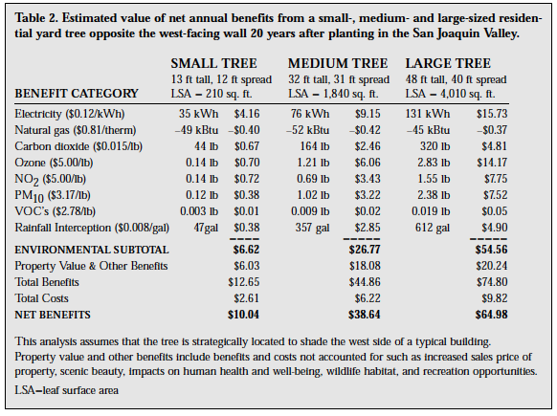
Step 3, option 1: Back at their desks, students use provided resources to understand how trees provide ecosystem services and estimate the work their trees are doing.
Community Tree Guides:
The US Forest Service published a series of regional Tree Guides to help people understand how trees provide ecosystem services and how to maximize those benefits. Table 2 (pg 30) shows some of the benefits for general large, medium, and small trees.
The appropriate tree guide is here:
https://www.itreetools.org/streets/resources/Streets_CTG/CUFR_38_Inland_Valleys_CTG.pdf
Notes:
This relates to NGSS Science & Engineering Practices (one of the three dimensions to our standards). There are eight practices, this task relates best to the practice of Analyzing and Interpreting Data.

Slide 10
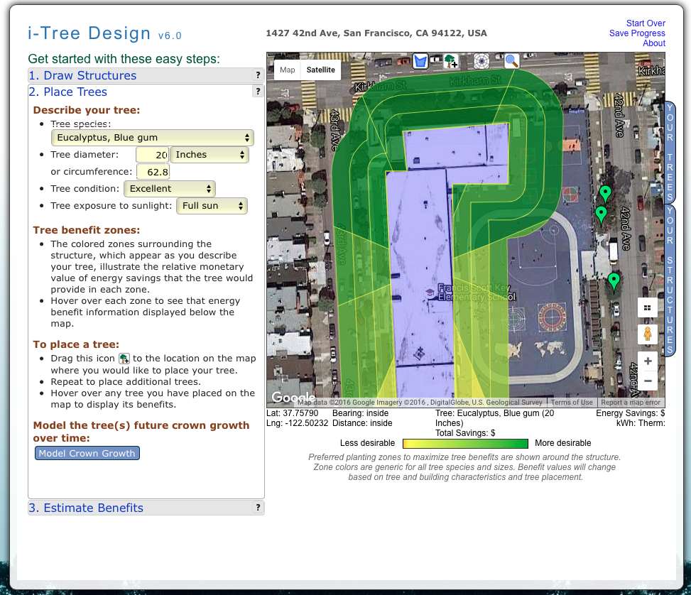
Step 3, option 2:
i-Tree Design:
This is an online tool that lets you “draw” your buildings and enter your trees and then calculates the benefits. If you don’t know the species of the tree, you can use the “Other” options. (Other broadleaf deciduous large, other evergreen conifer medium, etc.)
http://www.itreetools.org/design.php

Slide 11
Step 4: Students enter the ecosystem services of the three trees into the table and discuss results.
Which tree is providing the most benefits?
How much different are the benefits of the large tree than the small? 2x? 5x? 10x?
Discuss possible explanations for the differences. For example, where do the benefits arise from--the leaves, trunk, etc.? Do larger trees have more leaves, bigger trunks, more branches?
Discuss ways to increase the environmental benefits occurring on campus. Plant more trees? Plant bigger trees?
Tree # | Species/tree size | Energy conserved (kWh) | Stormwater filtered (gallons) | Greenhouse gases sequestered (lbs) | Air pollutants captured (lbs)
1 | Large | 131 | 612 | 320 | 6.78
2 | Medium

Slide 12
Data sheet

Slide 13
Data collection
Out in the field |  |  | Back at your desk
Tree number | Trunk circumference | Tree height | Energy conserved (kWh) | Stormwater filtered (gallons) | Greenhouse gases sequestered (lbs) | Air pollutants captured (lbs)

Slide 14
Aerial images of school grounds

Slide 15
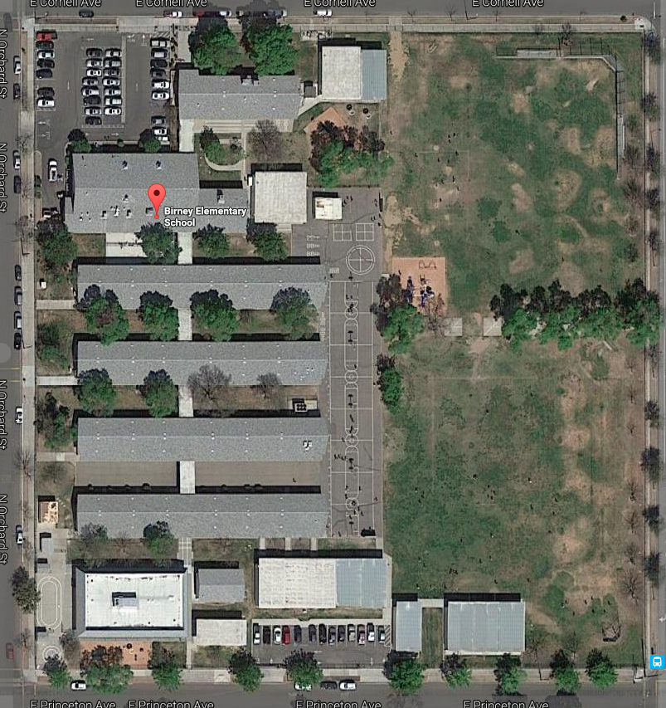
Birney Elementary

Slide 16
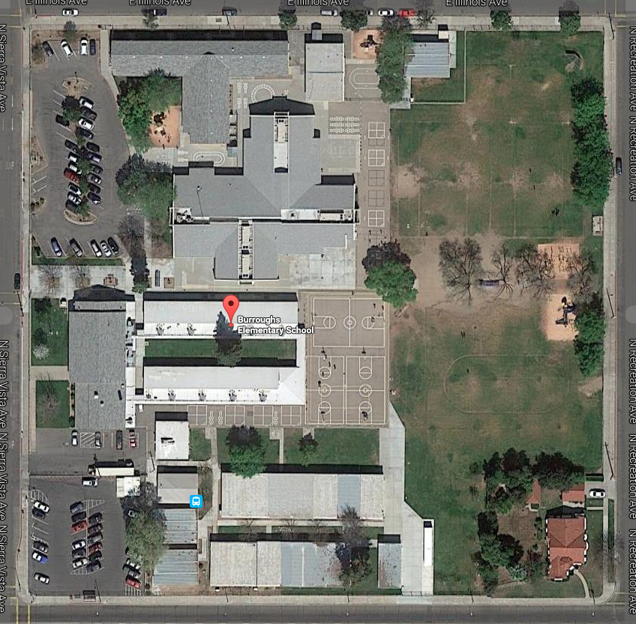
Burroughs Elementary

Slide 17
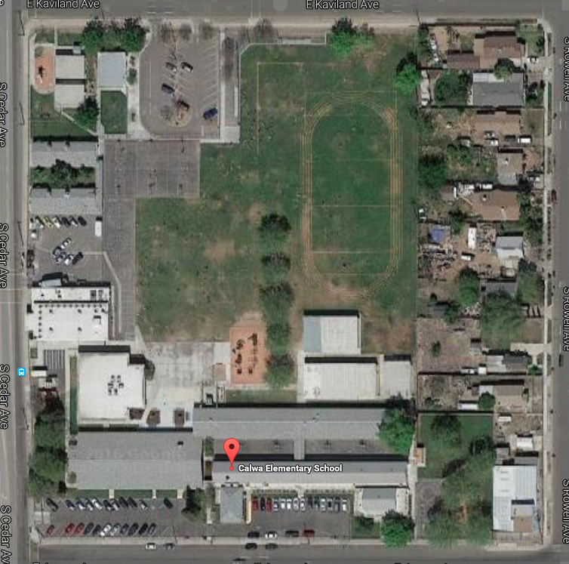
Calwa Elementary

Slide 18
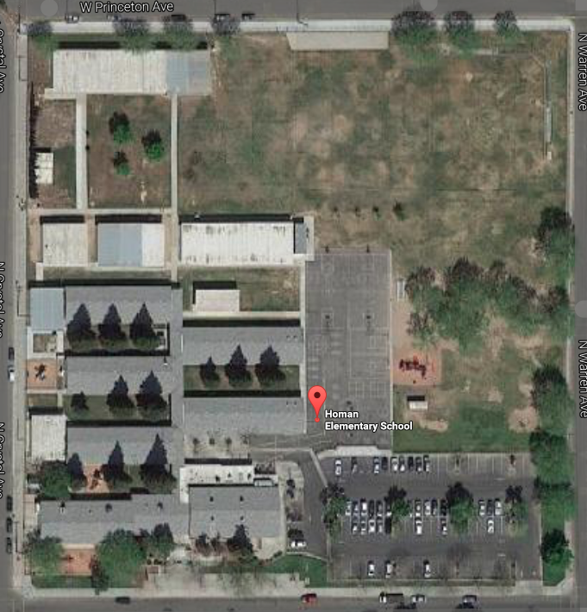
Homan Elementary

Slide 19
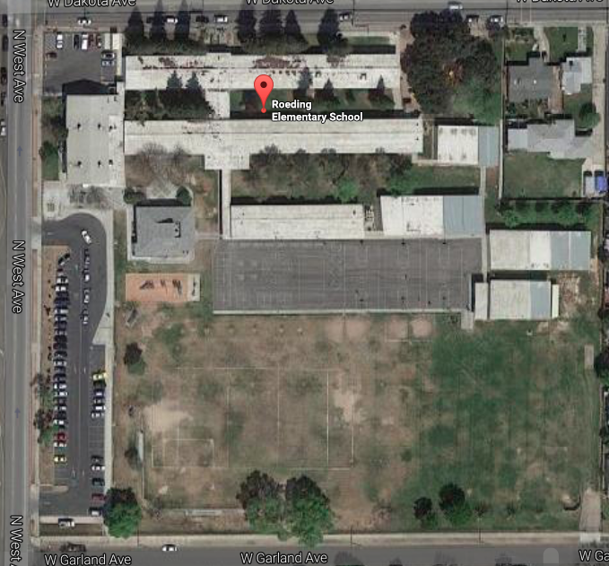
Roeding Elementary

Slide 20
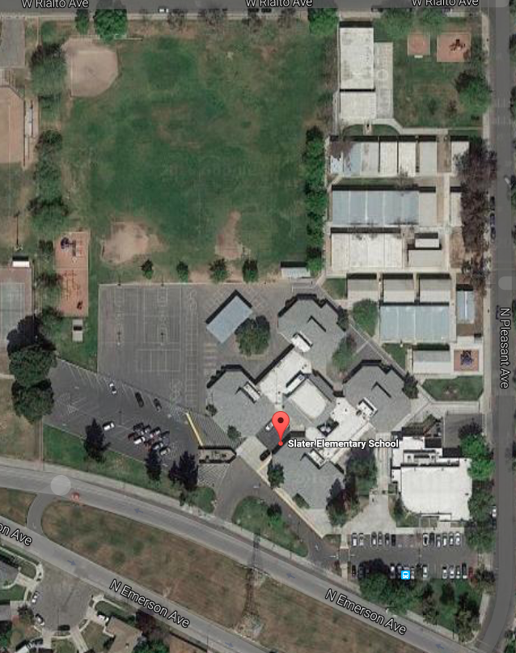
Slater Elementary

Slide 21
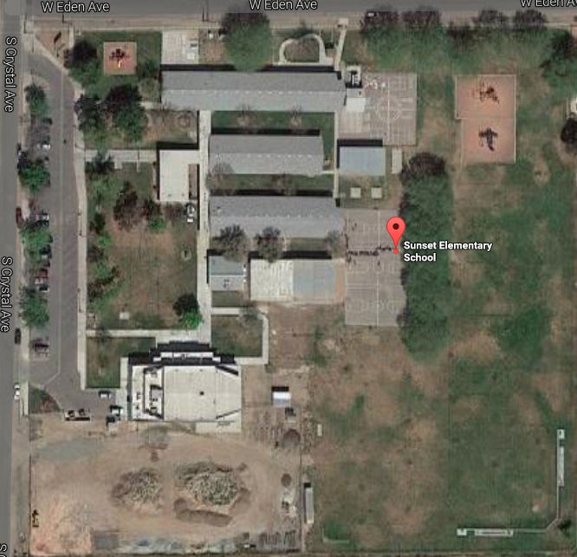
Sunset Elementary

Slide 22
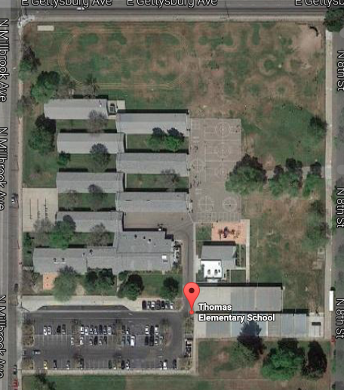
Thomas Elementary

Slide 23
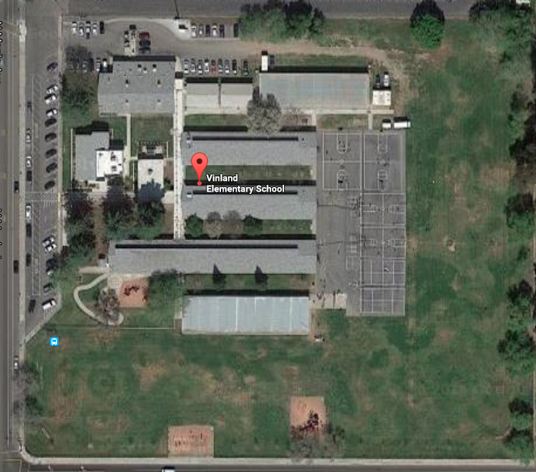
Vinland Elementary

Slide 24
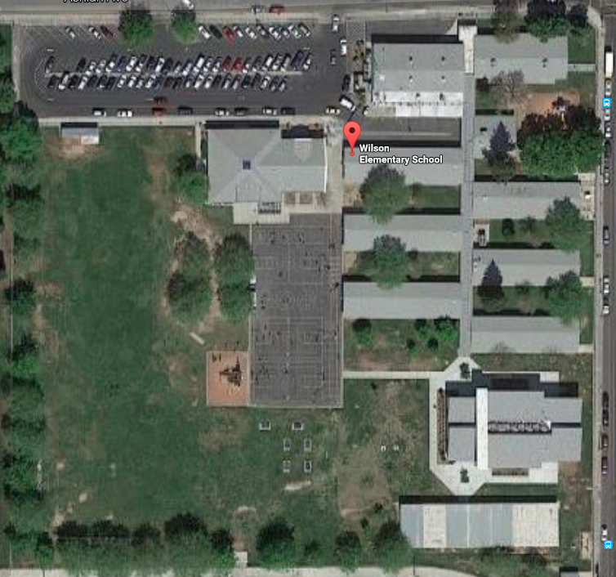
Wilson Elementary

